Slide 1

CODE CHASE

Slide 2

TEAM MEMBERS
Sai Rahul Reddy Bapuram
Satya Laxman Pranav
Pilla Venkata Sai Prashanth
Vamsi Krishna

Slide 3

INTRODUCTION
Our platform is designed to help users practice and enhance their coding skills, specifically in SQL. It offers a diverse range of coding problems covering various SQL topics, allowing users to:
Solve real-world SQL challenges.
Showcase their skills.
Test and improve their knowledge through practical exercises.
The platform serves as a valuable tool for anyone looking to strengthen their SQL proficiency and achieve mastery in database management.

Slide 4
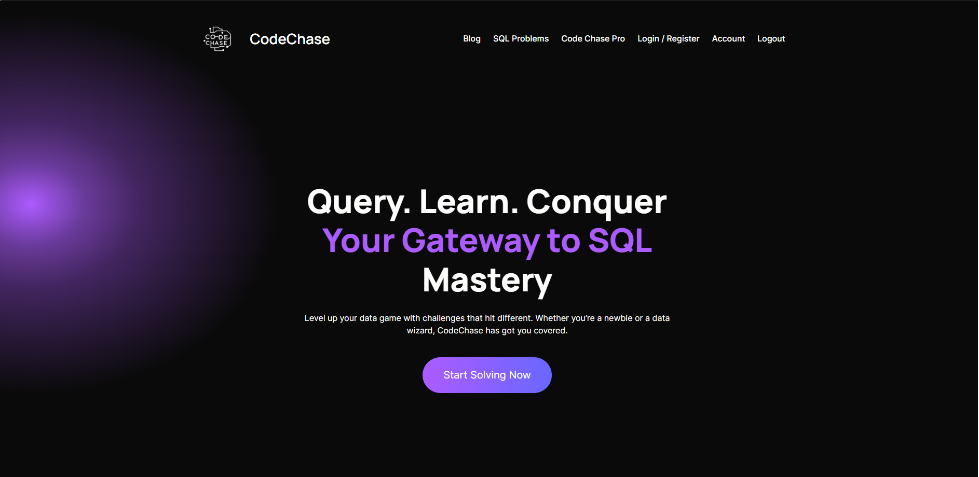
OVERVIEW OF YOUR DESIGN
User Access and Authentication
web Page:

Slide 5
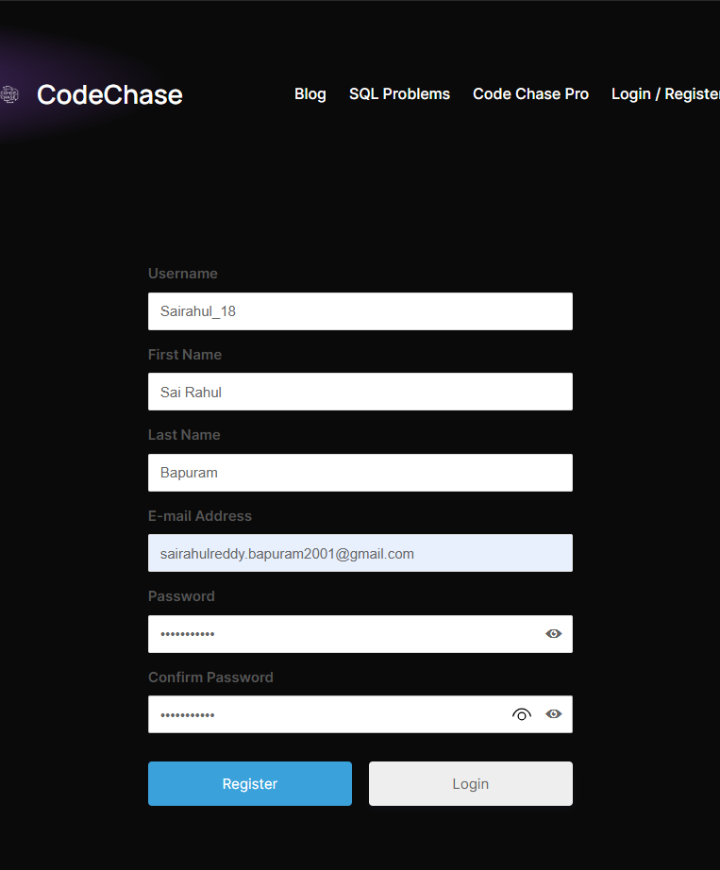
Registration Page
Collect user credentials (username, email, password).
Secure storage of sensitive information with encryption

Slide 6
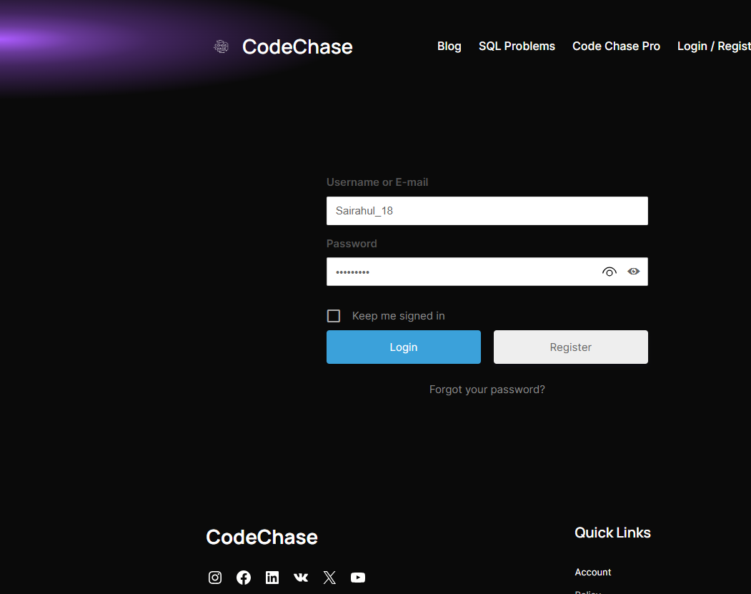
Login Page
User authentication using email/username and password.
Provides a seamless entry point for returning users.

Slide 7
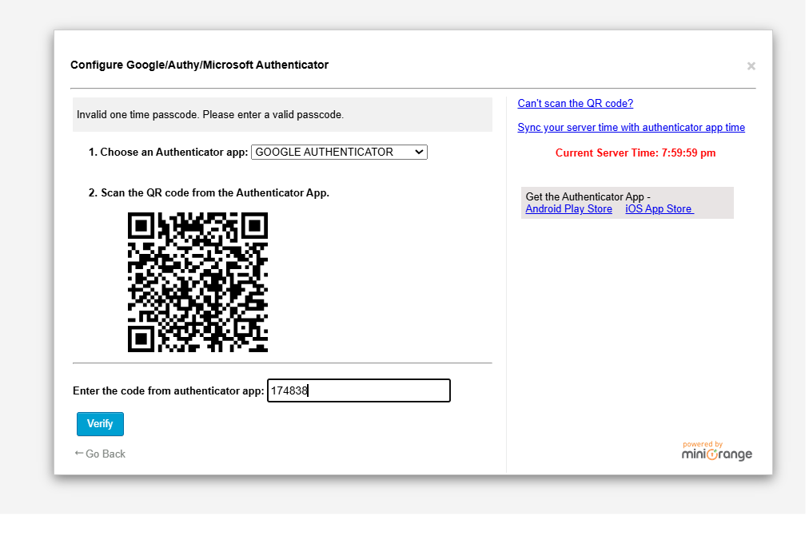
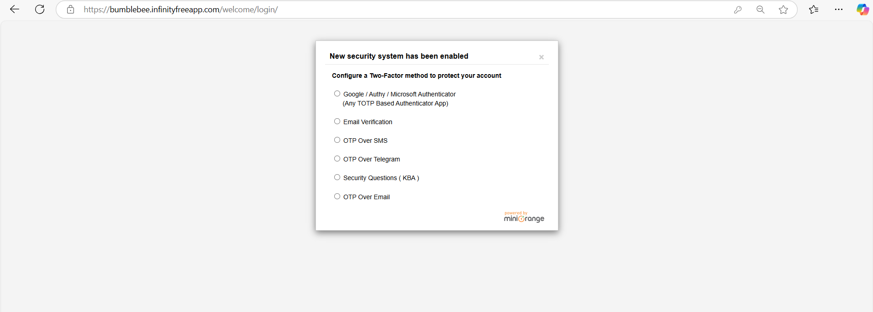
Multi-Factor Authentication (MFA)
Adds an additional layer of security using OTPs or app-based verification (e.g., Google Authenticator).

Slide 8
2. Core Functionalities
SQL Problem-Solving:
A rich library of SQL problems categorized by topics and difficulty levels.
Interactive coding interface where users can write, execute, and test SQL queries.
Test and Improve Skills:
Instant feedback on submissions.
Support for multiple test cases to validate solutions.
Performance tracking through analytics and stats.

Slide 9
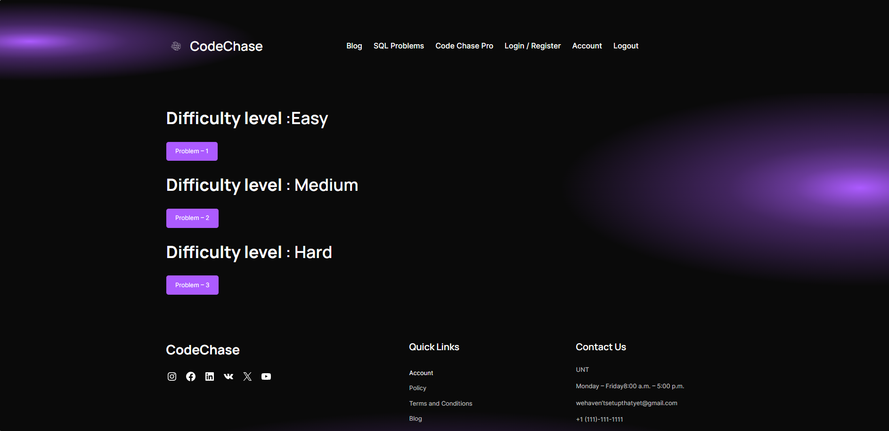
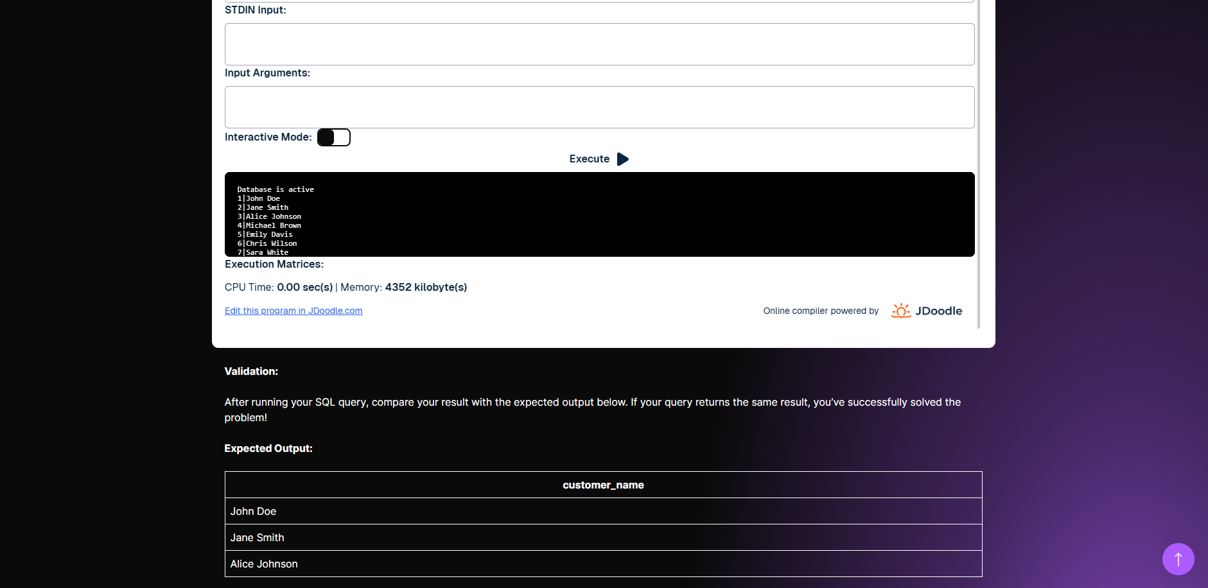

Slide 10
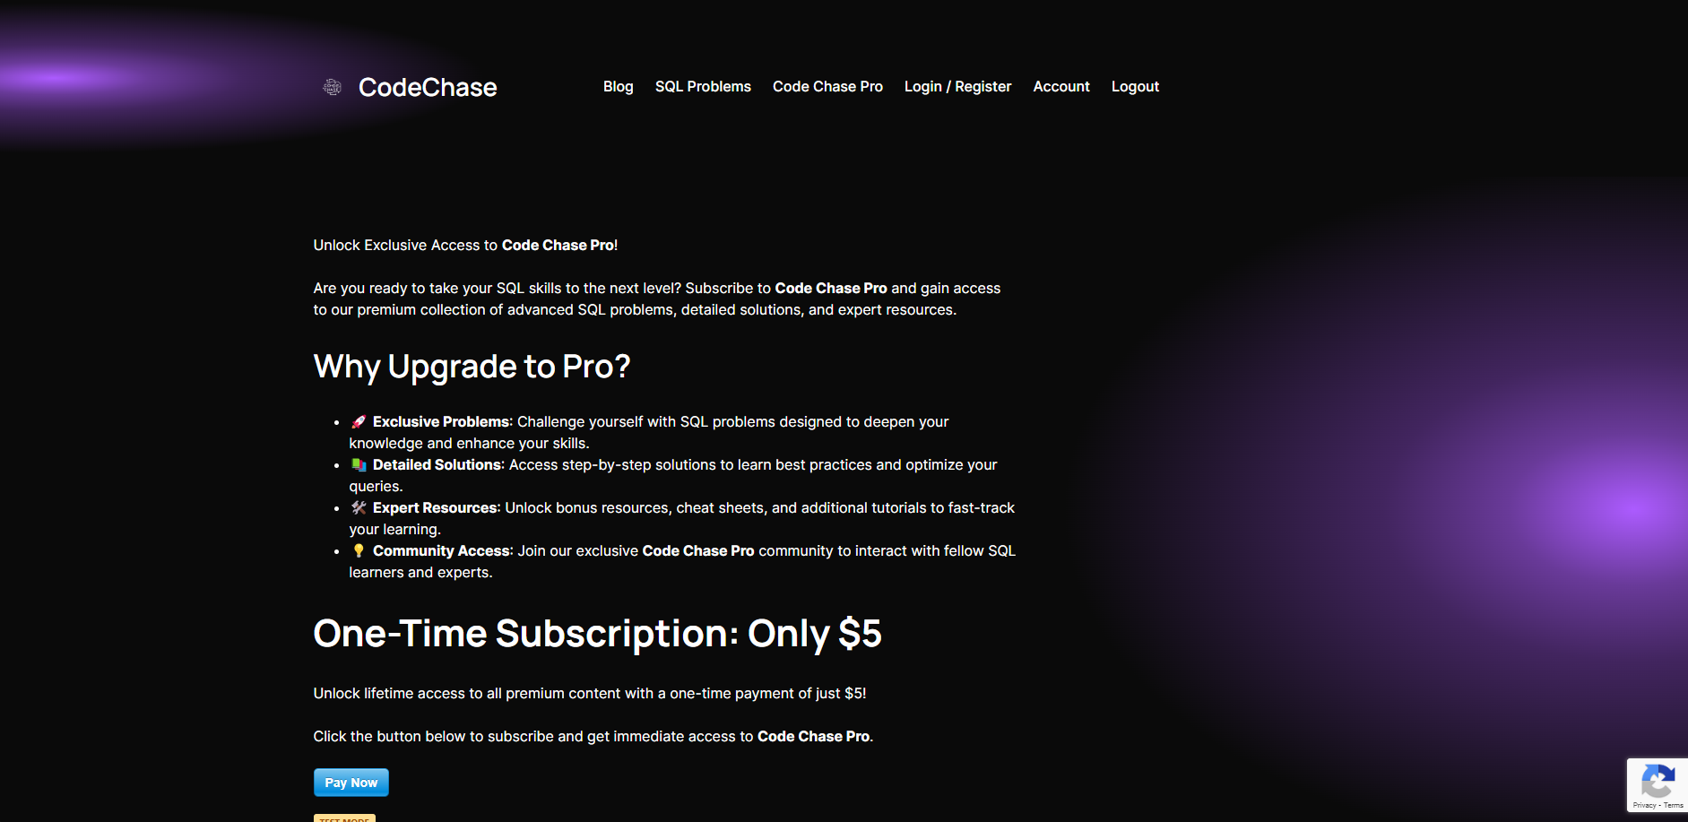
3. Payment and Premium Features
Payment Gateway:
Secure integration with payment providers (e.g., Stripe, PayPal) for processing subscriptions or one-time payments.

Slide 11
4. Technical Stack (Implied by Features)
Frontend:
Intuitive and responsive UI for a smooth user experience.
Backend:
Handles user authentication, code execution, and data processing.
Secure handling of financial transactions.
Database:
Stores user data, problems, solutions, and transaction records.
Code Execution Environment:
Isolated environment for safe execution of user-submitted SQL queries

Slide 12
5. Value Proposition
For Beginners:
Build foundational SQL skills through guided exercises.
For Professionals:
A platform to test advanced SQL knowledge and prepare for real-world scenarios.
For All Users:
A secure and engaging environment to continuously improve and showcase SQL expertise.

Slide 13
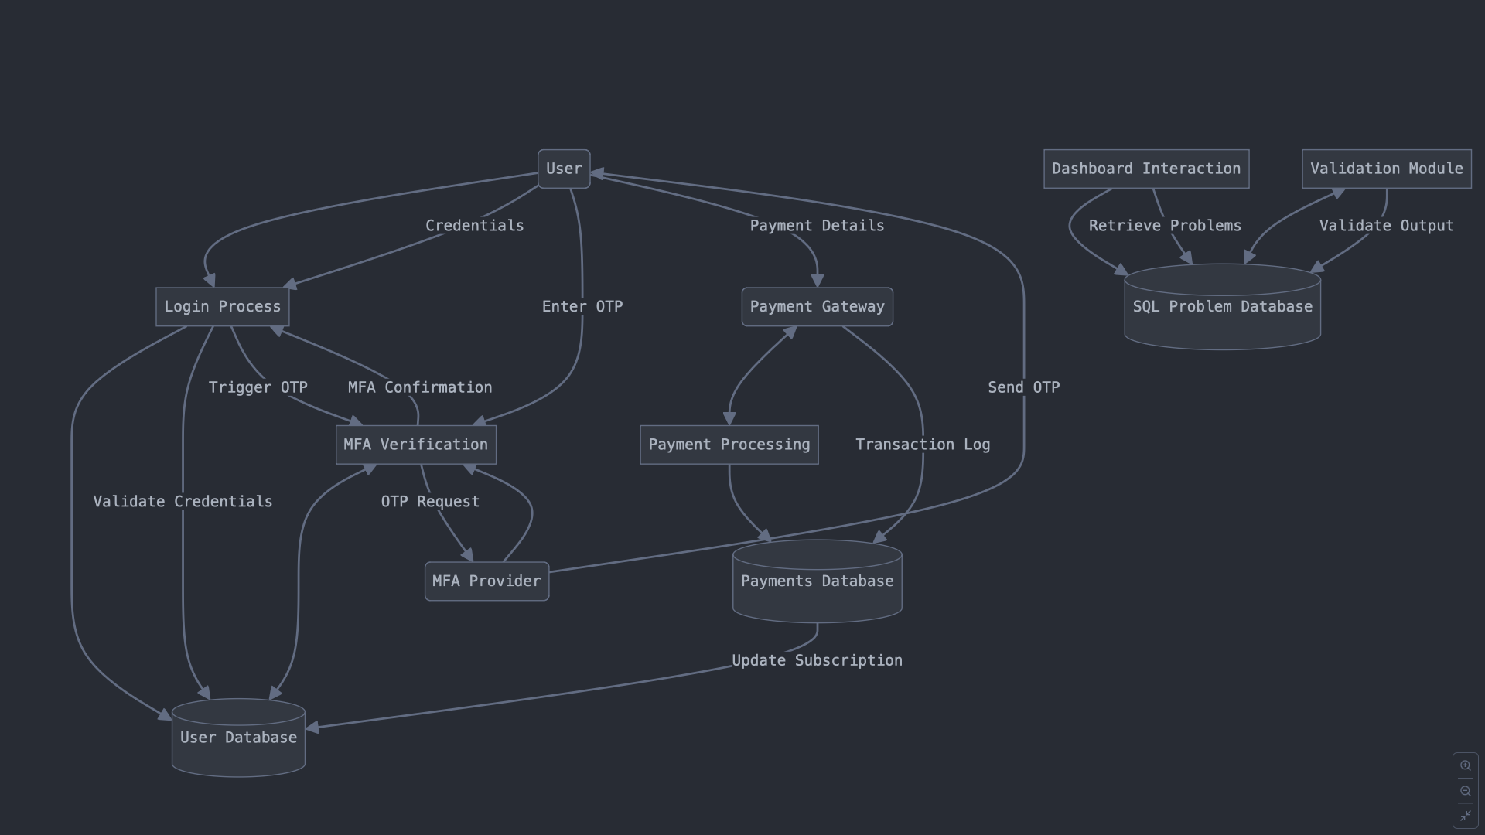
DATA FLOW
User logs in/registers → Credentials validated via MFA -> Stored in User Database.
User selects a problem → Data retrieved from SQL Problem Database.
User submits output → Validated through Validation Module.
User initiates payment → Processed via Payment Gateway → Subscription updated.

Slide 14
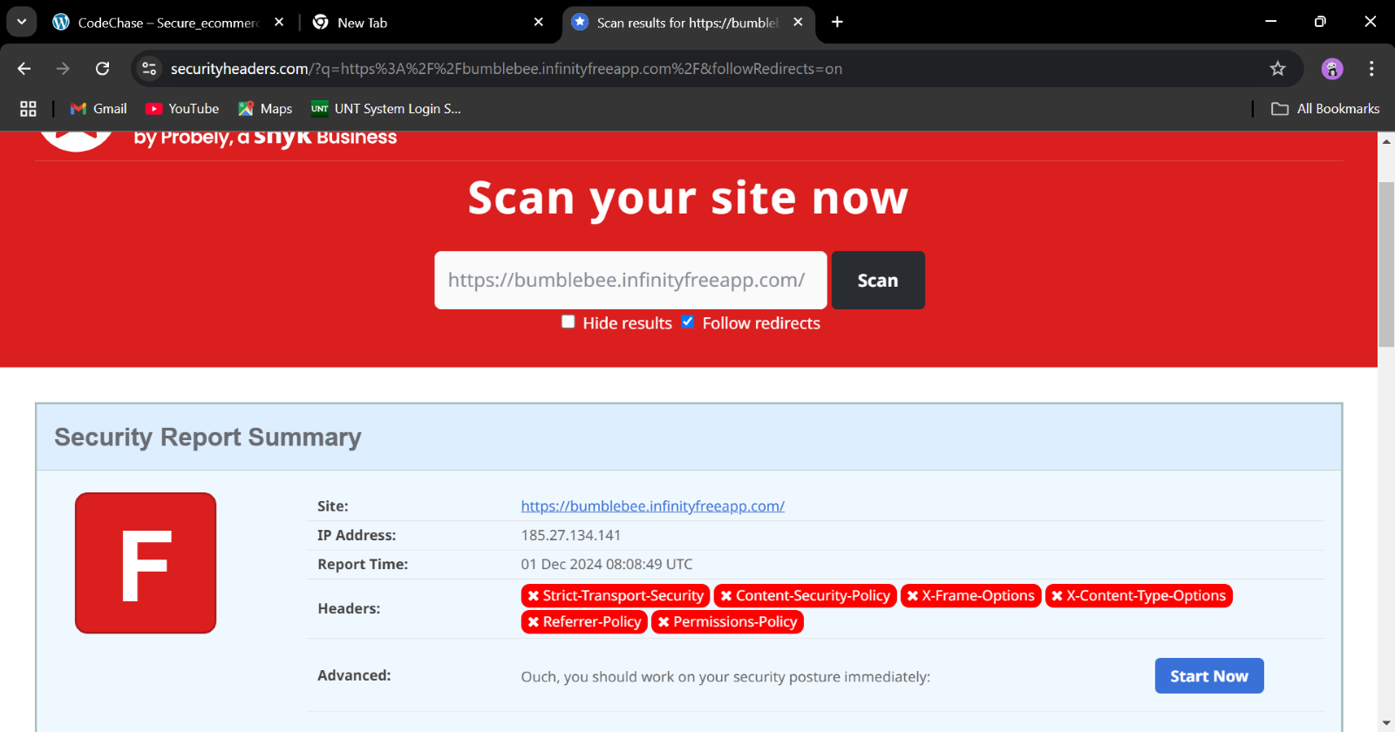
Vulnerability Assessment
Tools and Methods used to conduct the test:
1)Security Headers:

Slide 15
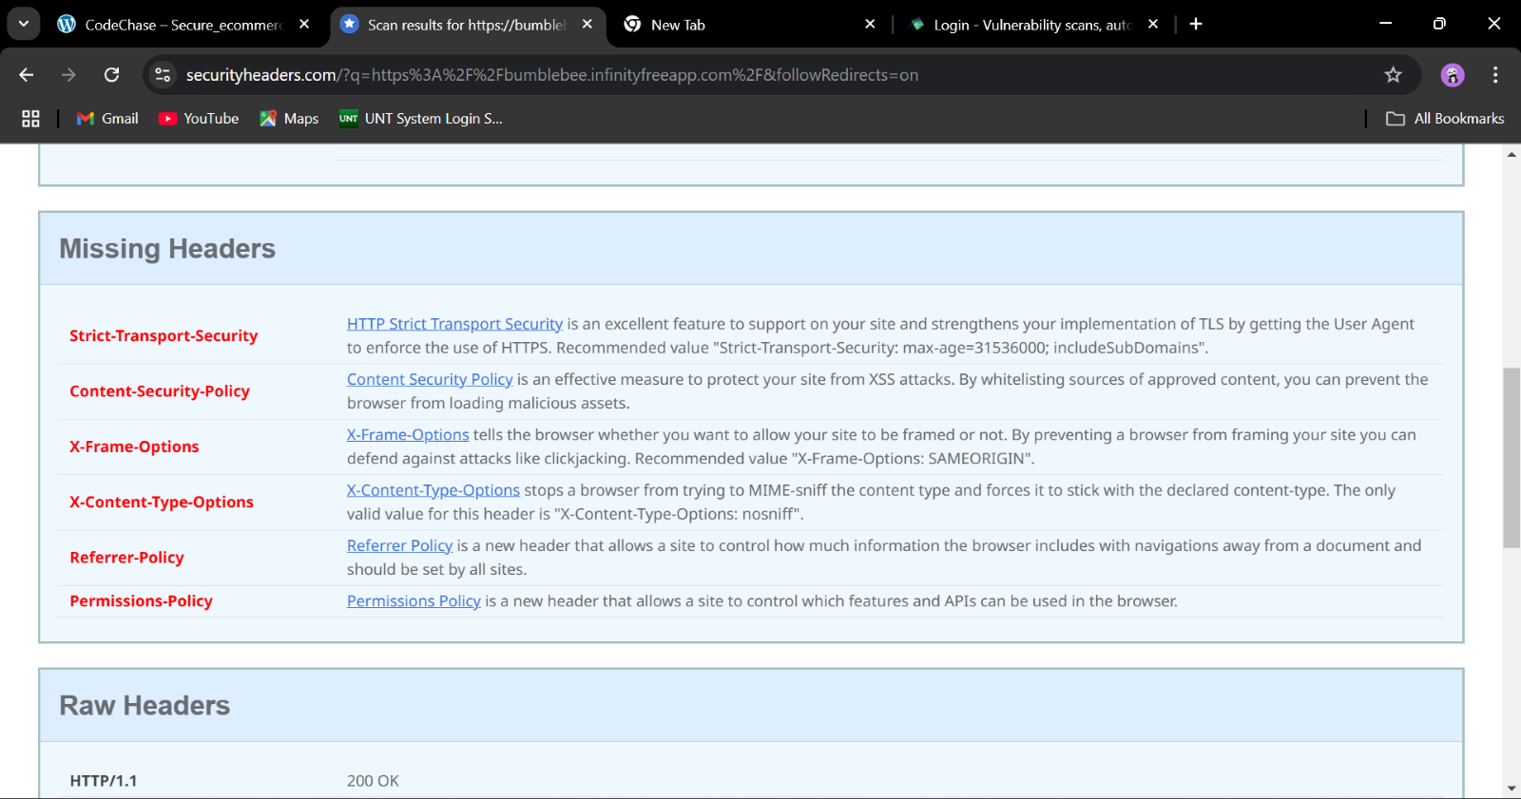
Security Headers

Slide 16
Security Headers
a) Strict-Transport-Security (HSTS)
Description: This header forces browsers to only interact with your website over HTTPS, even if the user tries to access it via HTTP.Impact of Missing:​
Site may be vulnerable to man-in-the-middle (MITM) attacks, especially during the initial HTTP request. Users may inadvertently interact with your website over an insecure connection. ​
Recommendation: Add the Strict-Transport-Security header​
b) Content-Security-Policy (CSP)
Description: Whitelists sources of content, such as scripts, styles, and images, to include on a page, diminishing the risk of XSS and data injection attacks.
Impact of Missing: Increased vulnerability to XSS and clickjacking, including other code injection attacks. Execute malicious scripts in the context of your application in your users' browsers.
Recommendation: Implement a strict CSP policy.
c) X-Frame-Options
Description: The X-Frame-Options HTTP header prevents your website from being embedded inside a frame of other websites. Clickjacking usually takes advantage of this.​
Impact of Missing: Your website may be embedded in malicious sites to trick users into performing unwanted actions like filling out sensitive information.​
Recommendation: Set the X-Frame-Options header​
​

Slide 17
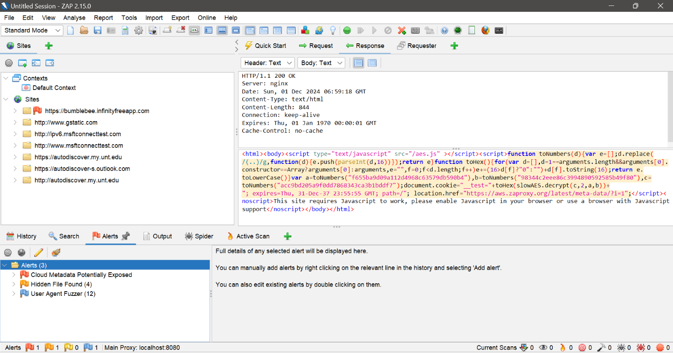
OWASP ZAP (Zed Attack Proxy)

Slide 18
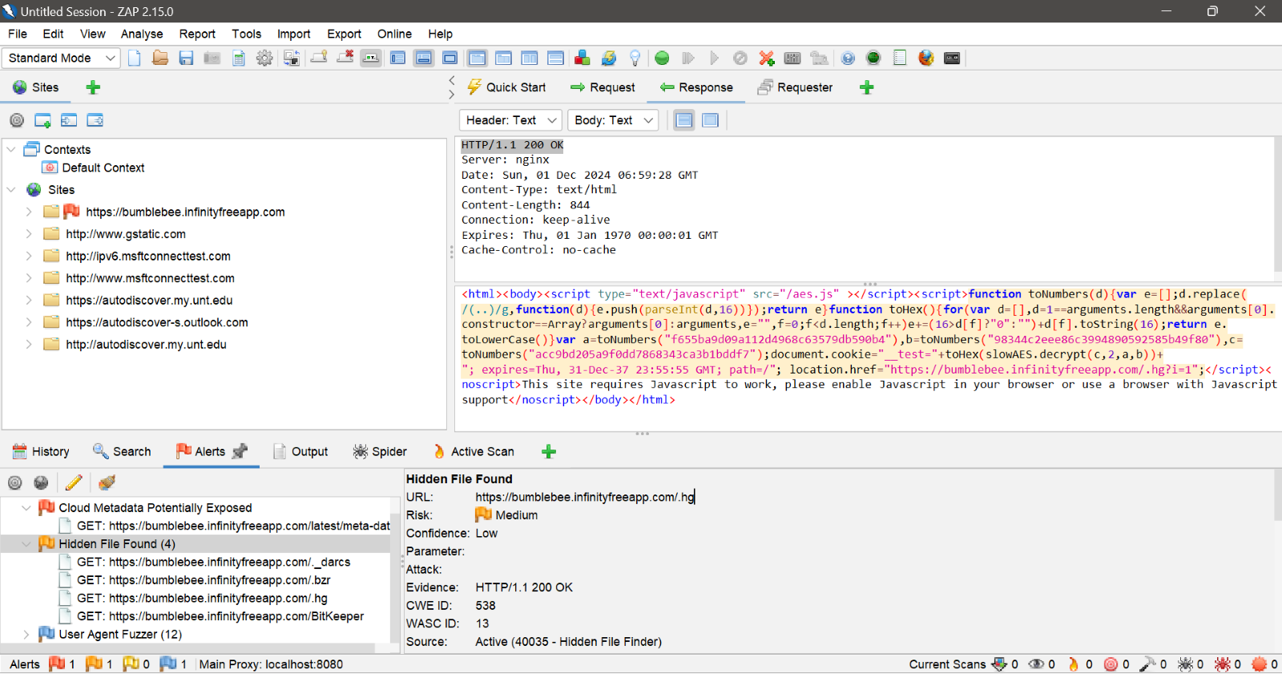

Slide 19
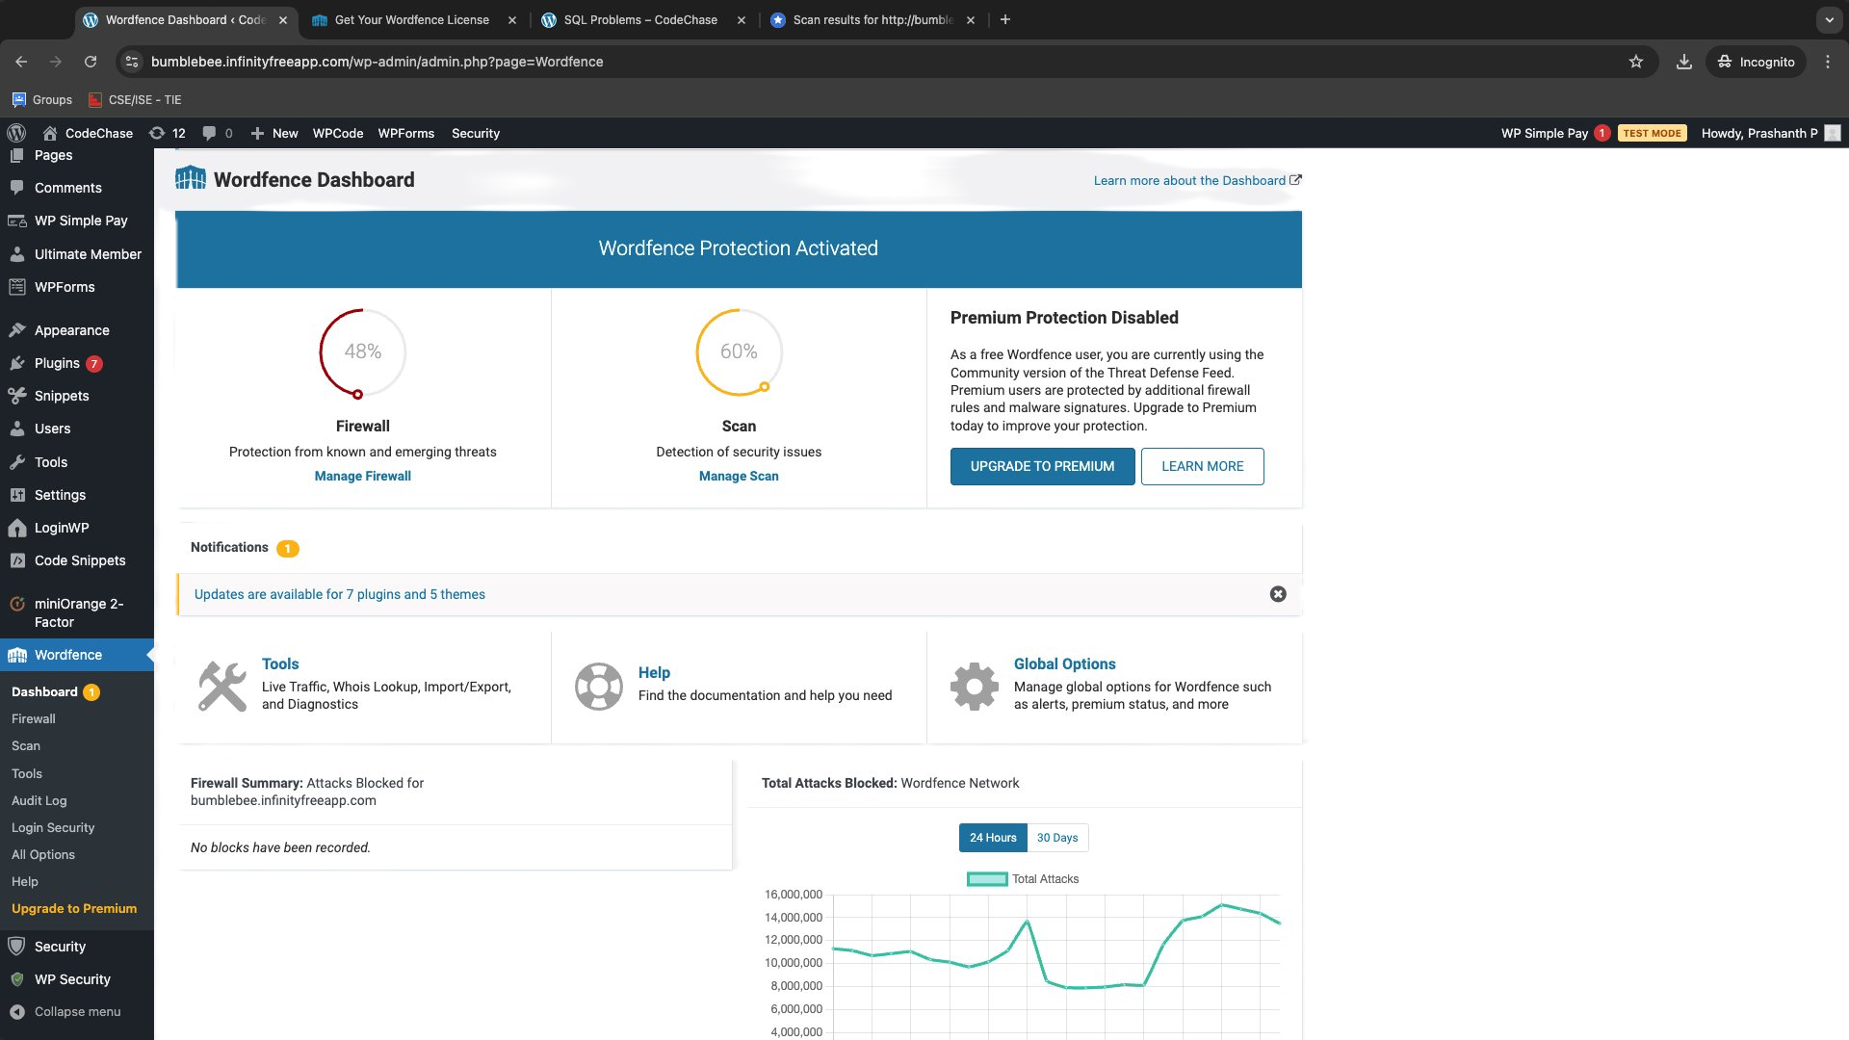
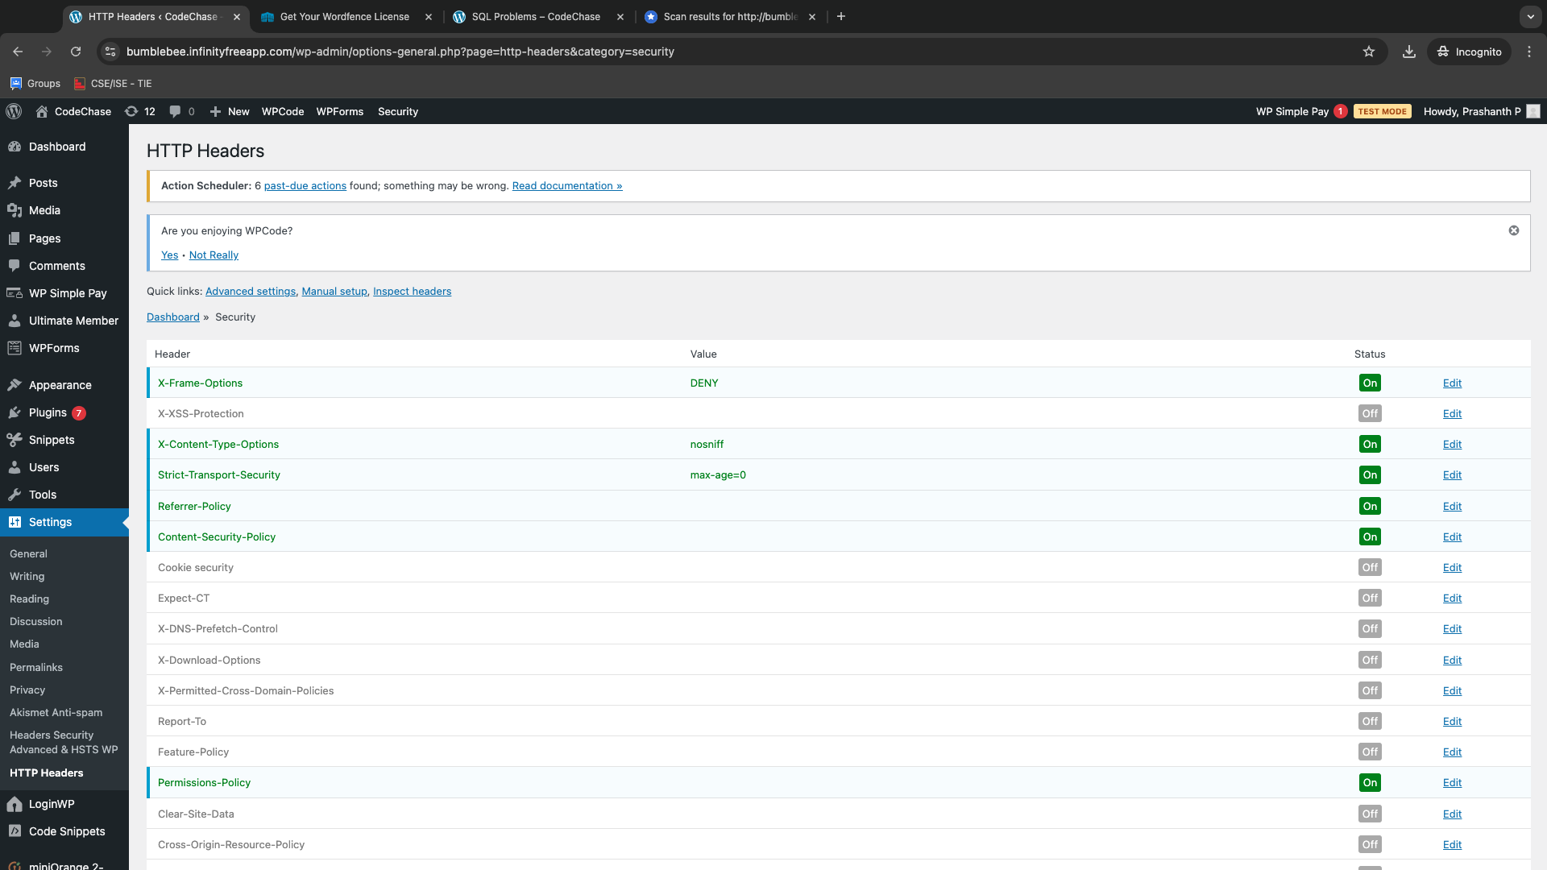
To address the vulnerabilities we have installed designated plugins from word press which helped us to overcome these vulnerabilities.

Slide 20
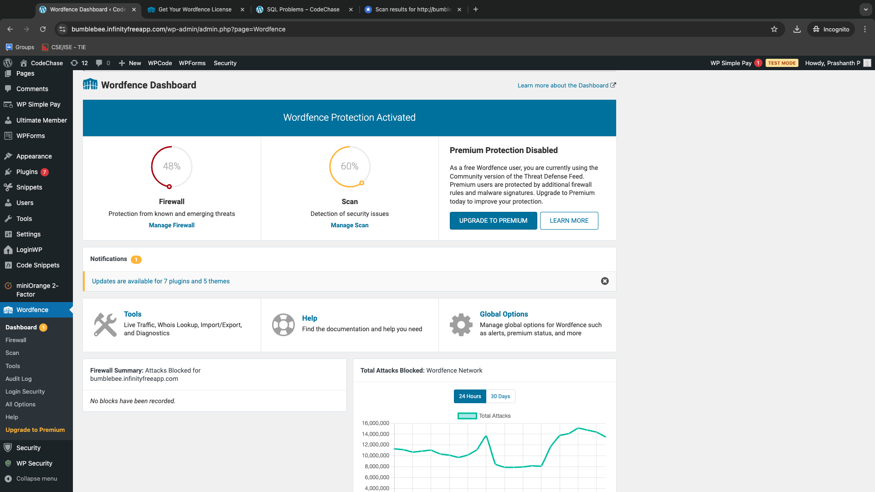
After receiving the scan results, highlighting critical security vulnerabilities such as missing HTTP headers, we took immediate steps to address these issues. To enhance the website's security posture, we implemented the Wordfence Security Plugin, providing robust firewall protection and malware scanning capabilities. Additionally, we utilized the HTTP Headers Plugin, which allowed us to configure and add the missing headers effectively.​
​
​
​
By leveraging these tools, we successfully added key headers, including Strict-Transport-Security, Content-Security-Policy, X-Frame-Options, X-Content-Type-Options, Referrer-Policy, and Permissions-Policy, thereby mitigating potential vulnerabilities and significantly improving the overall security of our web platform.​

Slide 21
Navigating Challenges
Security
User Experience
Ensuring security standards with HTTP headers and plugins.
Balancing user experience with functionality.
Setting up a secure payment gateway.
Maintaining design consistency across pages.

Slide 22
Conclusion
1
Success
2
Security First
Successfully developed a secure and interactive SQL learning platform.
Addressed security vulnerabilities using Wordfence and HTTP Headers plugins.
3
User Focus
Improved user experience with streamlined workflows and an intuitive interface.

Slide 23
Thank You
We appreciate your time and interest in our CodeChase. We hope you found this presentation informative.

